Slide 1
Introduction to the SharePoint Framework
Notes:
This module introduces students to the SharePoint Framework (SPFX) and the extensive API it provides for client-side development. Students will learn to create new SPFX projects using the Yeoman generator and to develop SPFX projects using Visual Studio Code. The module examines the different types of components that can be created with SPFX including Web Parts, Application Customizers, Field Customizers and Command Sets. Students will learn how to extend a Web Part with custom properties that can be viewed and edited by users in the Web Part Properties Pane. The module also teaches best practices for managing CSS styles in an SPFX project using SCSS files and CSS modules. Students will learn how to test and debug SPFX projects in the local SharePoint Workbench as well as in the hosted SharePoint Workbench running inside a test site in SharePoint Online.

Slide 2
Agenda
Introduction to the SharePoint Framework
Creating SPFX Projects using the Yeoman Generator
Testing & Debugging Webparts in SharePoint Workbench
Managing Styles using SCSS Files and CSS Modules
Creating a Web Part with Custom Properties
Creating Application Customizers

Slide 3
Evolution of the SharePoint Platform
Farm Solutions
Server-side DLLs and XML-based Definitions
Sandboxed Solutions
SharePoint Apps Add-ins
iFrames used to add in extra security dimension
Introduced complexity with 2 domains (app web vs host web)
JavaScript Injection
Scripting can be disabled in SharePoint Online
No formal deployment model
SharePoint Framework
A natural evolution and formalization of JavaScript Injection model

Slide 4
SharePoint Framework (SPFx)
Getting Started with the SharePoint Framework
Your write your logic using client-side TypeScript code
You can use any JavaScript libraries (e.g. React, Knockout, etc.)
Your code runs under the identity of the current user
You don't worry about authenticating the user - it's already done
You can leverage the APIs added by SharePoint Framework
You create components like webparts and application customizers
SharePoint Page
SPFx Component 1
SPFx Component 2
TypeScript
TypeScript
Knockout
React

Slide 5
SPFx versus the SharePoint Add-in Model
SPFx is quite different from SharePoint Add-in model
SPFx components hosted directly on page, not in iFrame
SPFx components rendered using DOM of hosting page
No more confusion over "host web" versus "app web"
SPFx developer experience is completely different
SPFx uses modern tools (npm, Yeoman, gulp and webpack)
Requires move from Visual Studio to Node.js & Visual Studio Code
Considerations for migrating to SharePoint Framework
SPFx is replacement for SharePoint-hosted add-in model
SPFx has nothing similar to provided-hosted add-in model

Slide 6
SharePoint Framework Webparts
Webparts play central role in SharePoint Framework development
SPFx webparts designed to run on modern pages
SPFx webparts can also be added to classic pages
Developing Webparts
You create webparts using classes defined in Typescript
Webpart class inherits from base class defined by SPFx APIs
SPFx support webpart lifecycle methods (e.g. render, load, serialize. etc.)
SPFx APIs provide easy access to content in SharePoint and Office 365
SharePoint Page (modern or classic)
Client-side Web Part 1
Client-side Web Part 2
TypeScript
TypeScript
Knockout
React
SharePoint REST API
Microsoft Graph API

Slide 7
SharePoint Framework Component Types
SPFx allows you to create several styles of webparts
Standard Webparts
React Webparts
SPFx also provides several other Application Extensions
Application Customizer
Field Customizers
Command Sets
Modern SharePoint Page
Application Extension 1
Client-side Web Part 1
Client-side Web Part 2
Application Extension 2

Slide 8
Installing Packages for SPFx Development
Install Gulp (version 3)
Install Yeoman
Install Yeoman Template for SPFx
npm install -g gulp@3
npm install -g yo
npm install -g @microsoft/generator-sharepoint

Slide 9
Agenda
Introduction to the SharePoint Framework
Creating SPFX Projects using the Yeoman Generator
Testing & Debugging Webparts in SharePoint Workbench
Managing Styles using SCSS Files and CSS Modules
Creating a Web Part with Custom Properties
Creating Application Customizers

Slide 10
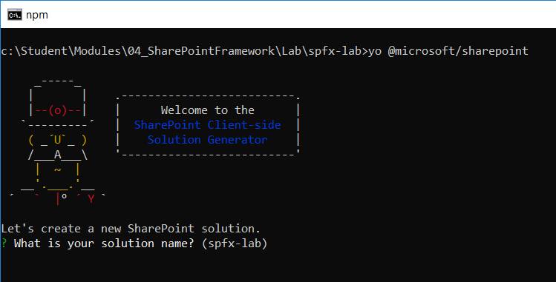
Using the SPFx Yeoman Template
SPFx projects created with Yeoman template
Template provides wizard-like experience when creating new project
yo @microsoft/sharepoint

Slide 11
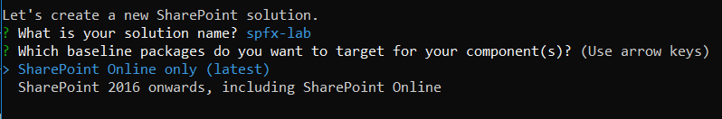
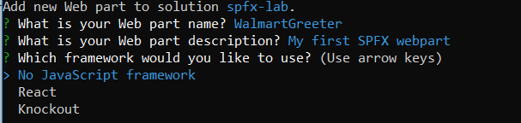
Answering Questions about a New Project
Do you want to support SharePoint On-premises?
Do you want to create a webpart or an SPFx extension
Do you want to create a standard webpart or a React webpart

Slide 12
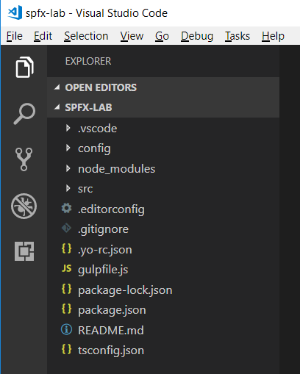
SharePoint Framework Project Structure
Project created as Node.js project

Slide 13
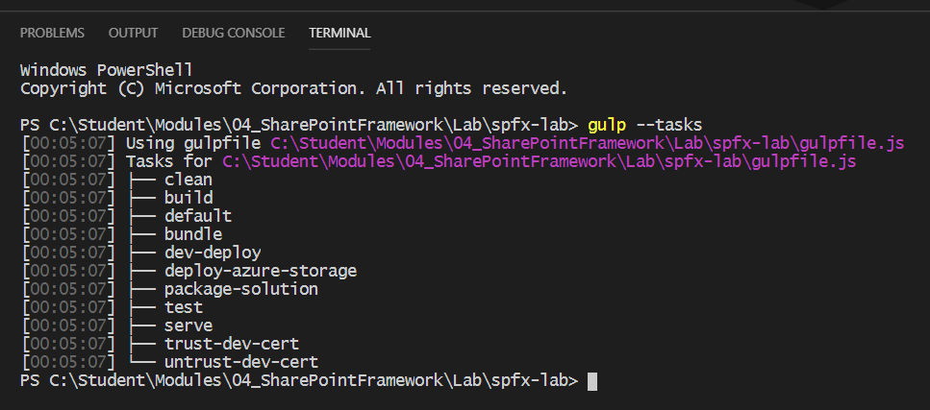
SharePoint Framework Adds Gulp Tasks
Run gulp --tasks to see SPFx gulp tasks added to project

Slide 14
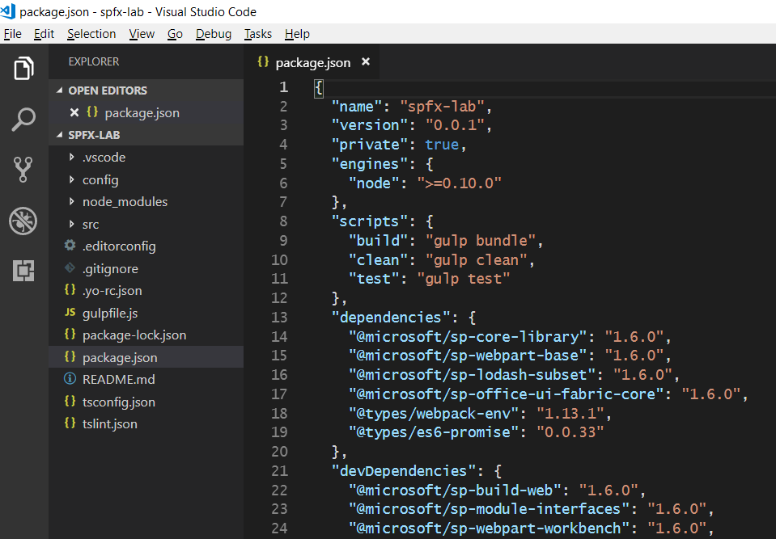
Package.json
SPFx API Version Number

Slide 15
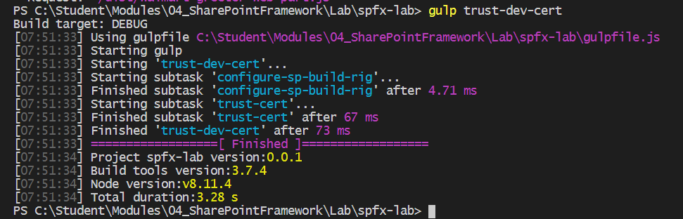
Running gulp trust-dev-cert
Testing SPFx code requires self-signed certificate
Certificate used serve pages with SSL at https://localhost
Certificated created and registered using gulp trust-dev-cert
gulp trust-dev-cert must be run within project directory
However, you only have to run this command once
No need to run gulp trust-dev-cert on a per-project basis

Slide 16
Agenda
Introduction to the SharePoint Framework
Creating SPFX Projects using the Yeoman Generator
Testing & Debugging Webparts in SharePoint Workbench
Managing Styles using SCSS Files and CSS Modules
Creating a Web Part with Custom Properties
Creating Application Customizers

Slide 17
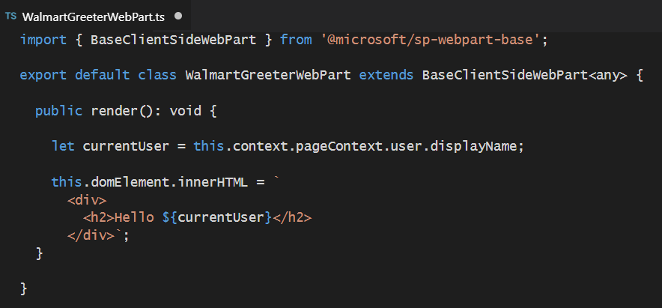
The "Hello World" SPFx Webpart
Webpart class must extend BaseClientSideWebPart
Override render() for minimal “hello world” functionality
Base class provides API though context and pageContext
Base class provides domElement to access hosting page DOM

Slide 18
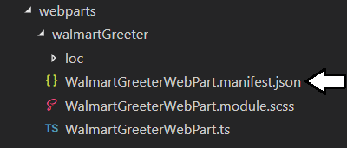
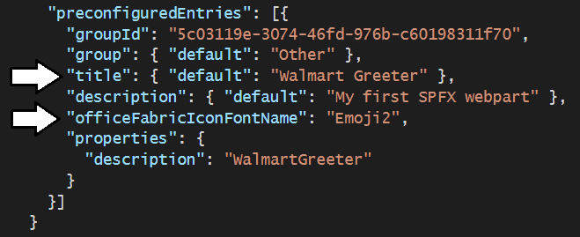
Webpart Manifest
Each webpart requires its own manifest file
Manifest file automatically added by SPFx Yeoman template
Update manifest to set webpart title and icon

Slide 19
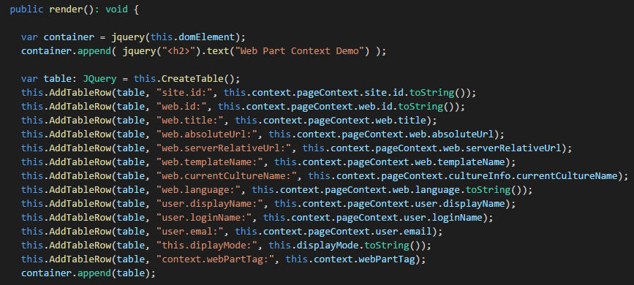
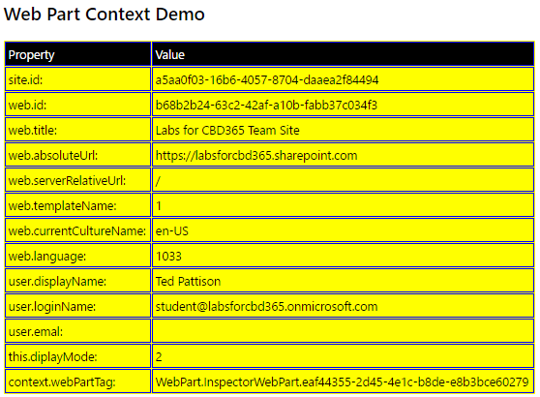
Web Part Context

Slide 20
Hello World with SPFx

Slide 21
Agenda
Introduction to the SharePoint Framework
Creating SPFX Projects using the Yeoman Generator
Testing & Debugging Webparts in SharePoint Workbench
Managing Styles using SCSS Files and CSS Modules
Creating a Web Part with Custom Properties
Creating Application Customizers

Slide 22
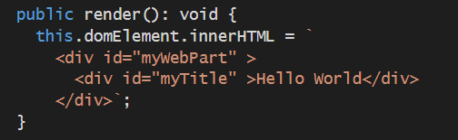
Issues with CSS in Web Development
CSS can be hard to manage in large applications
Global style names can conflict with one another
Component CSS should not affect other parts of page
Component CSS should be isolated
You should avoid using element IDs in CSS
Prefer using classes instead of IDs
You should create class names unique across page
Bad, Bad, Bad - do not use IDs in a webpart

Slide 23
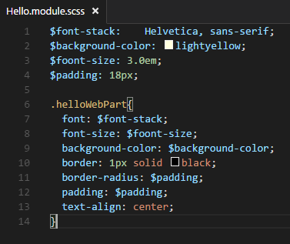
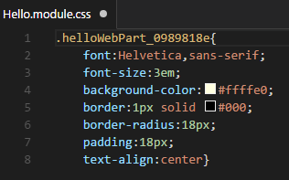
Working with SASS and .SCSS Files
SPFx uses Syntactically Awesome Style Sheets (SASS)
Styles maintained in .scss files instead of .css files
SASS is superset of CSS with variables, selector nesting & mixins
SASS compilation occurs when you build project using gulp build
Webpack compiles .scss files into .css files
SASS compilation generates unique style names
helloWebPart renamed to helloWebPart_0989818e
SASS

Slide 24
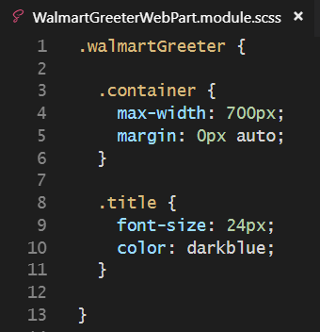
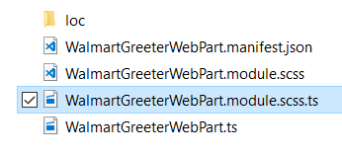
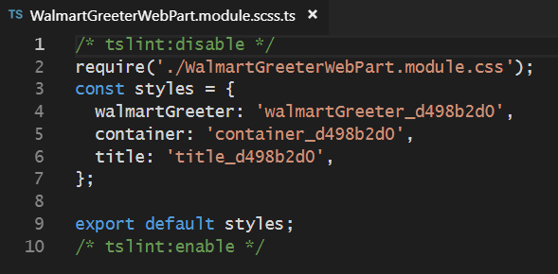
SCSS Compilation Generates TypeScript File
SASS compilation also generates TypeScript file
Used to provide strongly-types style names in TypeScript code

Slide 25
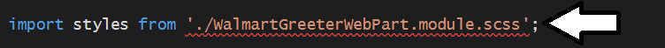
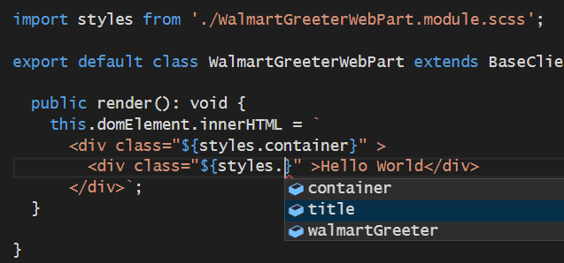
Importing Style Names in a TypeScript File
You can run gulp build to force SASS compilation
import statement to .scss file displays error until you run gulp build
Once compiled, SCSS styles names can be referenced in TypeScript

Slide 26
Agenda
Introduction to the SharePoint Framework
Creating SPFX Projects using the Yeoman Generator
Testing & Debugging Webparts in SharePoint Workbench
Managing Styles using SCSS Files and CSS Modules
Creating a Web Part with Custom Properties
Creating Application Customizers

Slide 27
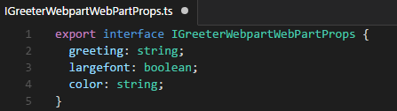
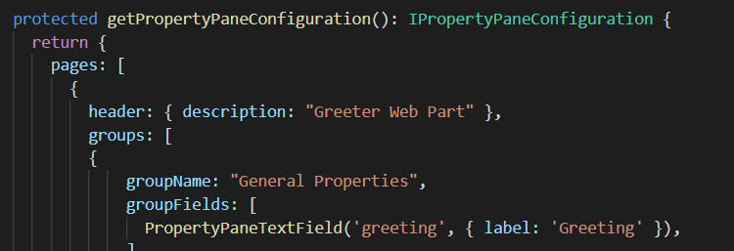
Web Part Properties
Define interface with properties
Add interface to web part class definition
Override getPropertyPaneConfiguration()

Slide 28
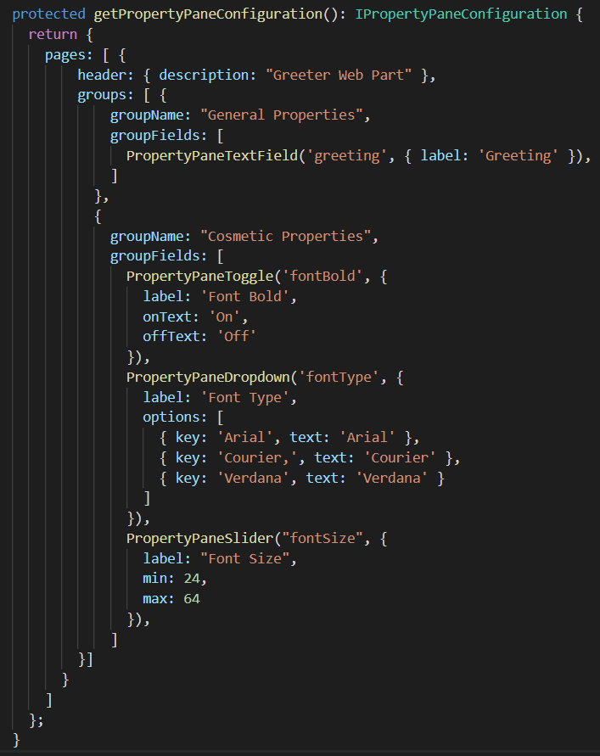
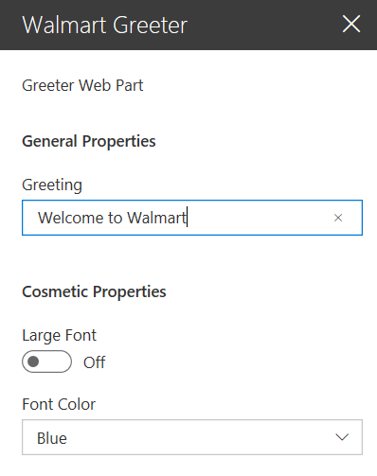
Property Panel Settings

Slide 29
Web Part Properties

Slide 30
Agenda
Introduction to the SharePoint Framework
Creating SPFX Projects using the Yeoman Generator
Testing & Debugging Webparts in SharePoint Workbench
Managing Styles using SCSS Files and CSS Modules
Creating a Web Part with Custom Properties
Creating Application Customizers

Slide 31
SPFx Application Extensions
Application Customizers
Used to add page header and/or page footer into modern pages
Application customizers not supported in classic pages
Field Customizers
Used to add client-side behavior on top of site columns
Allows you to create custom field rendering experience
Command Sets
Allows you to add custom commands into SharePoint UI
SPFx component for creating user custom actions
Users invoke commands which trigger your client-side code

Slide 32
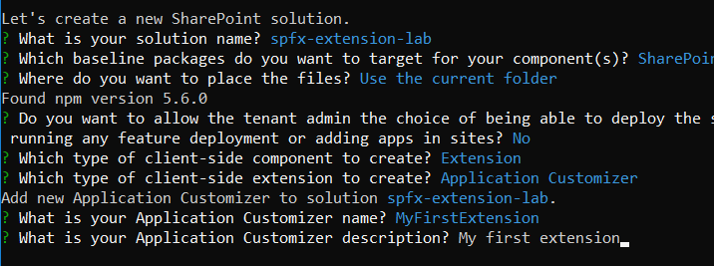
Creating an Application Customizer
Yeoman templates support creating application extension
You can choose between the 3 types of application extensions

Slide 33
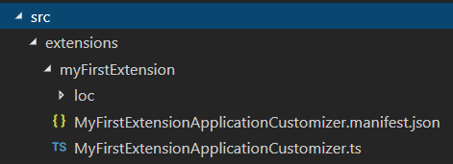
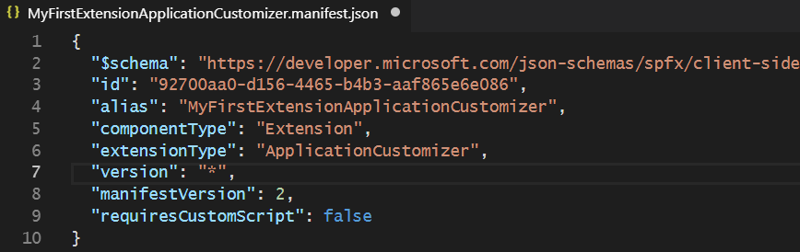
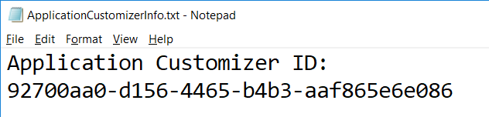
The Application Customizer Manifest

Slide 34
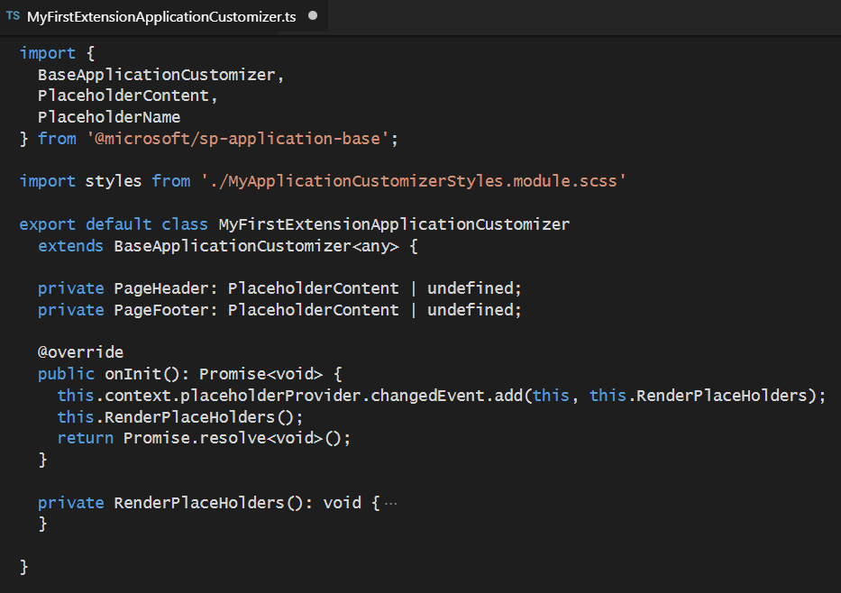
Implementing an Application Customizer

Slide 35
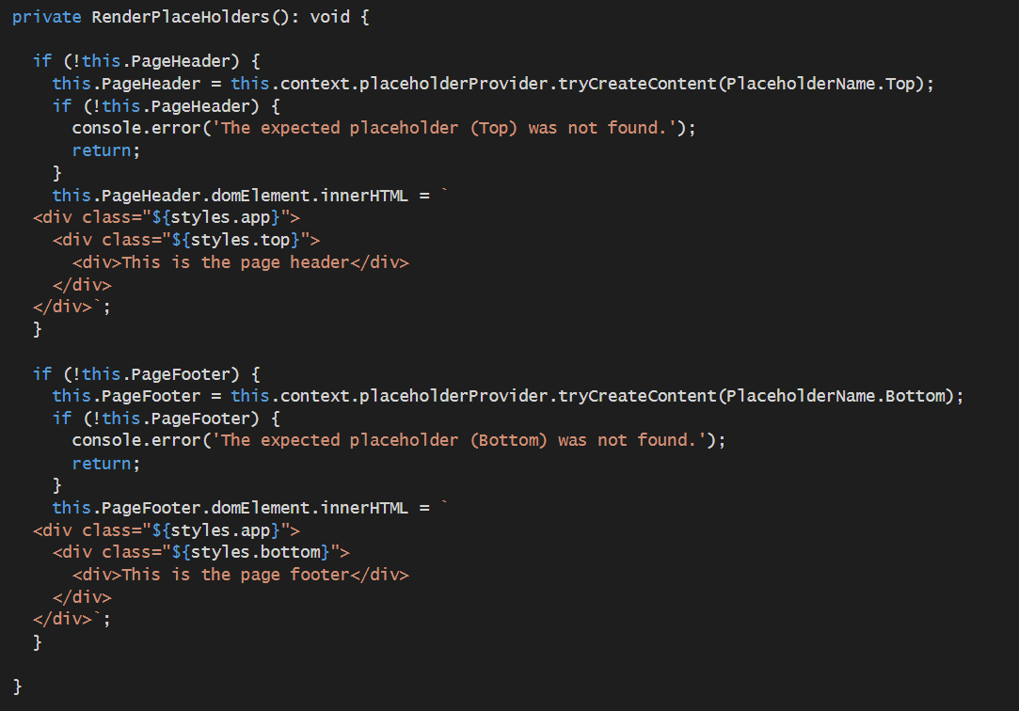
Rendering Content into Placeholders

Slide 36
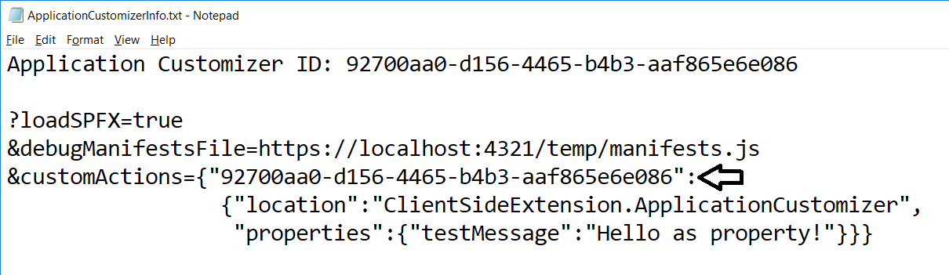
Debugging an Application Customizer
You must build debug URL with query string parameters
You must add GUID which is application customizer ID
Next, you copy and paste URL into browser address bar

Slide 37
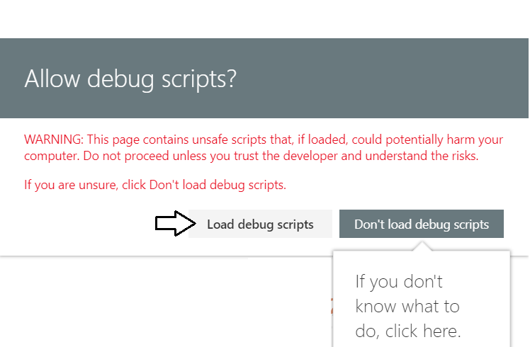
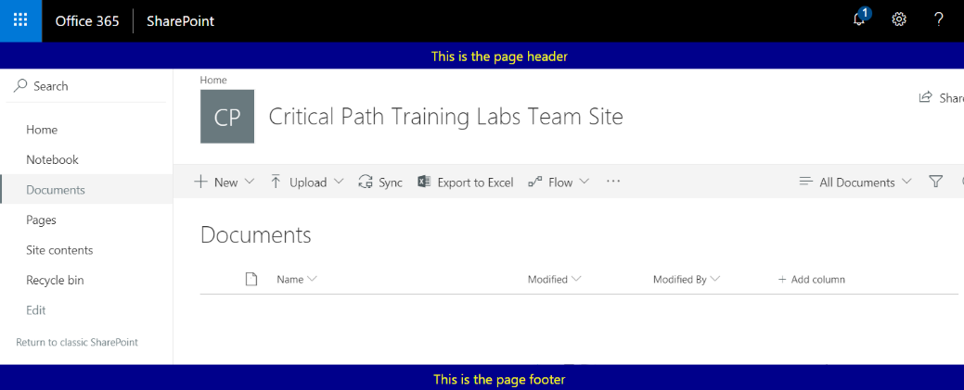
Testing the Application Customizer

Slide 38
Summary
Introduction to the SharePoint Framework
Creating SPFX Projects using the Yeoman Generator
Testing & Debugging Webparts in SharePoint Workbench
Managing Styles using SCSS Files and CSS Modules
Creating a Web Part with Custom Properties
Creating Application Customizers

